Slide 1
Super store : data analytics
IBM HACKATHON PROJECT
Presented By:
1. Name :- Dheeraj Kumar Sharma
2. University :- Haridwar University
3. Department :- CSE

Slide 2
OUTLINE
Problem Statement (Sample Super Store )
Proposed System/Solution
Algorithm & Deployment
Result (Output Image)
Conclusion
Future Scope
References

Slide 3
Problem Statement
The Sample Super Store represents a large retail business that sells a wide range of products across multiple categories such as furniture, office supplies, and technology, serving customers in different regions and segments. Due to the high volume and diversity of transactional data, the raw dataset contains inconsistencies and is not immediately suitable for analysis.
Dataset contain inconsistent retail data
Need to clean and structure data
Generate visual insights
Support data-driven decisions

Slide 4
Proposed Solution
To address the problem, the proposed solution is to adopt a structured data analytics workflow using IBM watsonx.ai Studio and IBM Data Refinery. The solution begins with creating a cloud-based analytics project and securely importing the Sample Super Store dataset into the platform. Using Data Refinery, the raw retail data is prepared and refined by organizing columns, handling inconsistencies, and structuring the dataset for analysis.
Once the data is prepared, visual analytics techniques are applied to explore and interpret the data. Various charts such as pie charts, bar charts, and Pareto charts are generated to analyze sales distribution, category-wise and region-wise performance, and identify the most significant contributors to overall sales. This step-by-step approach converts raw transactional data into clear, visual insights, enabling better understanding of business performance and supporting informed decision-making

Slide 5
System Approach
Create project in IBM watsonx.ai Studio
Upload the dataset
Clean and prepare data using IBM Data Refinery
Analyze data with charts and visualizations
Generate insights for decision-making

Slide 6
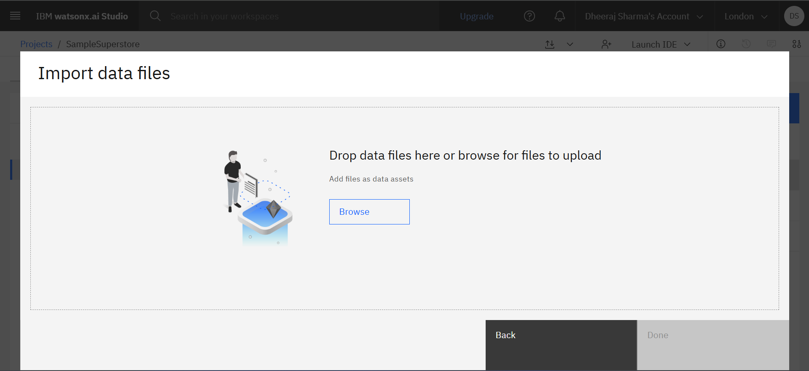
Result
.

Slide 7
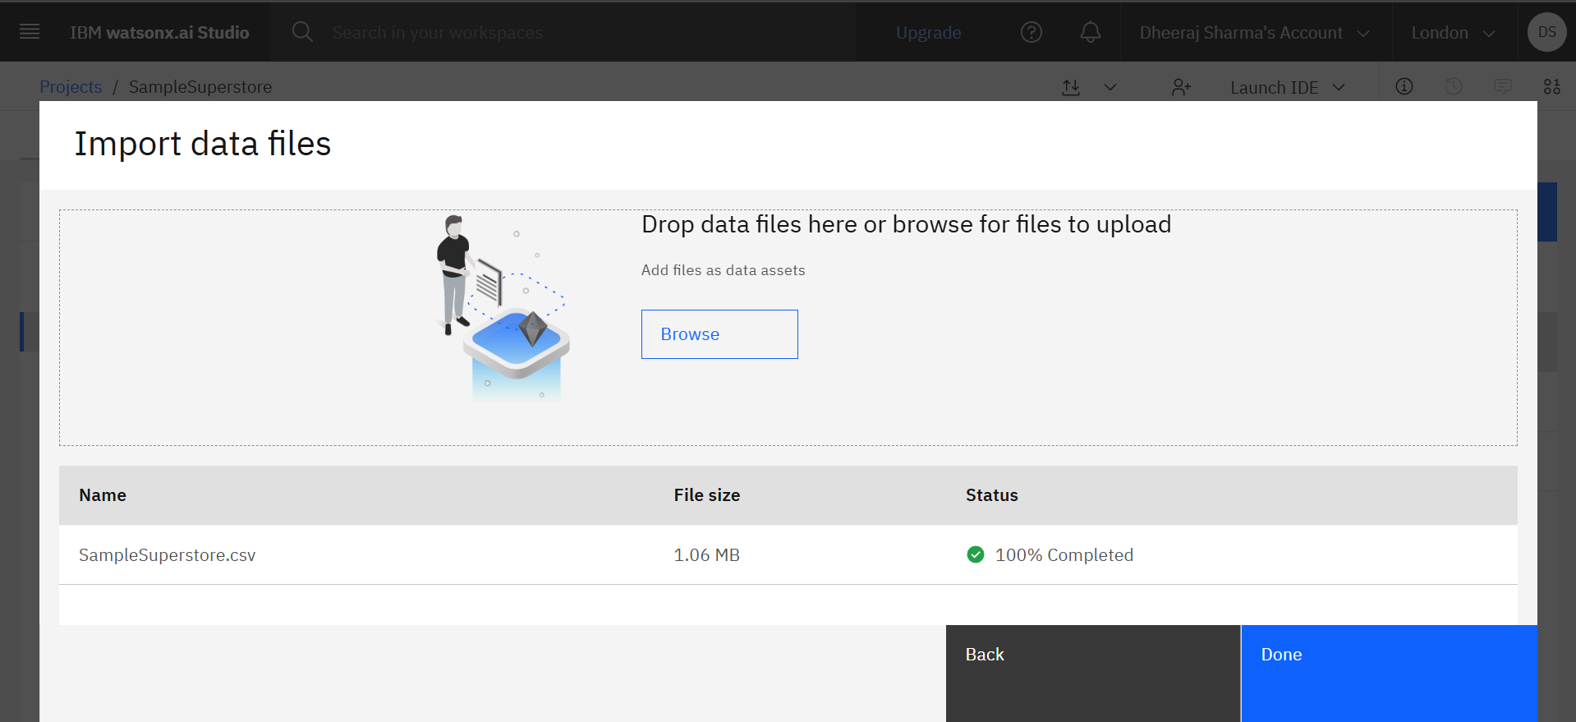
Result

Slide 8
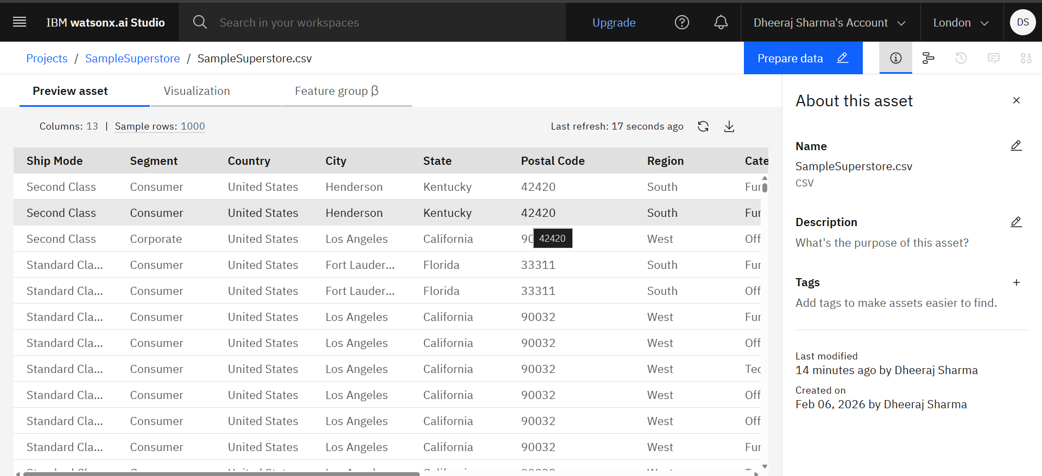
Result

Slide 9
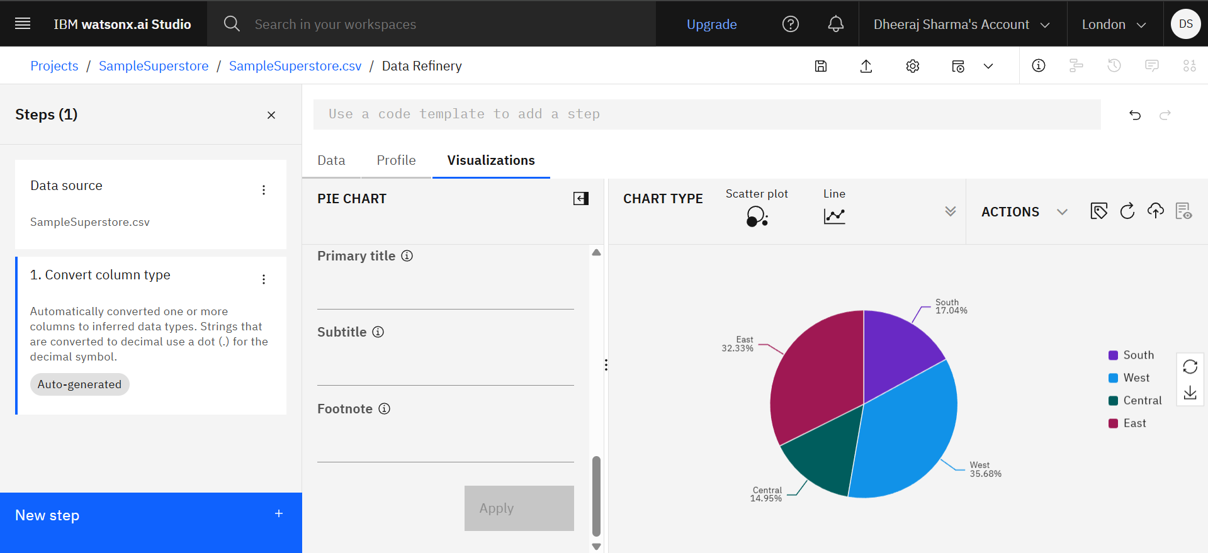
Result

Slide 10
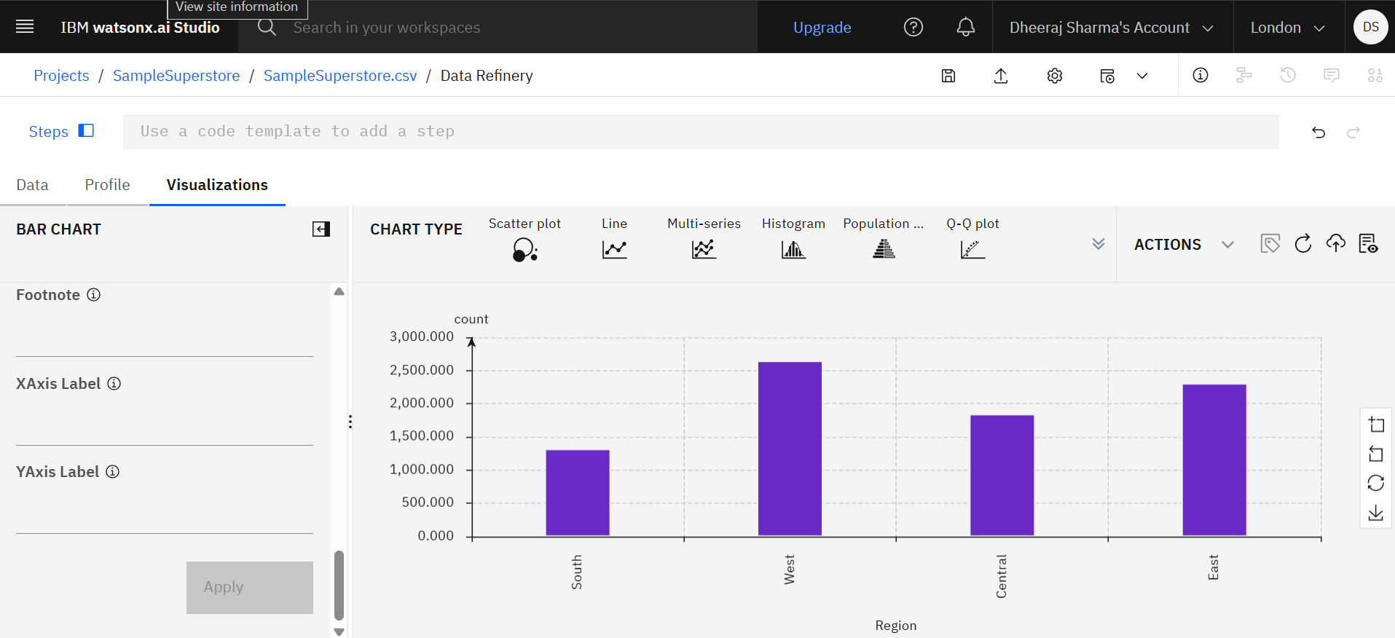
Result

Slide 11
Conclusion
This project demonstrated how IBM watsonx.ai Studio and IBM Data Refinery can be used to perform efficient end-to-end data analytics on retail data. By importing, cleaning, and organizing the dataset, raw transactional data was transformed into a structured and analysis-ready format. Visualization techniques such as pie charts, bar charts, and Pareto charts helped identify sales patterns, key contributors, and overall business performance. The project highlights that cloud-based analytics tools improve data accuracy, simplify analysis, and support informed, data-driven decision-making.

Slide 12
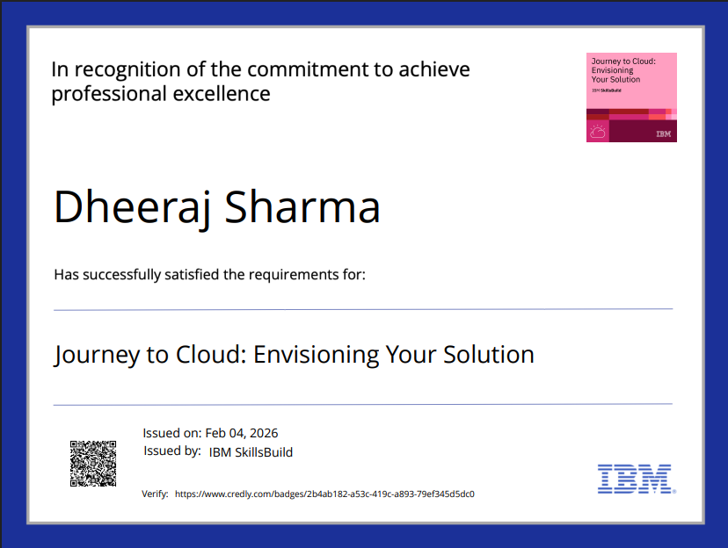
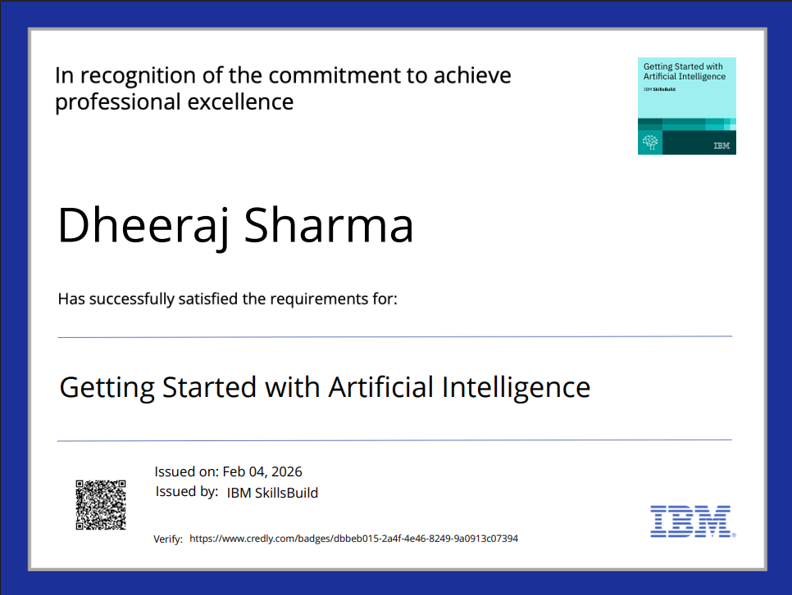
CERTIFICATES

Slide 13
Future scope
Apply predictive analytics to forecast future sales
Integrate machine learning for deeper insights
Enable real-time data analysis
Develop interactive dashboards and automated reports
Expand the system for large-scale business use.

Slide 14
References
IBM Cloud Documentation – IBM Cloud Platform Overview
IBM watsonx.ai Studio – Data Analytics and AI Services
IBM Data Refinery – Data Preparation and Visualization Tools
Sample Super Store Dataset – Retail Sales Analytics Dataset

Slide 15
THANK YOU

